Slide 1

Databases
Rangers 81
SQL VS No SQL

Slide 2
Agenda
Popular Databases
SQL
NoSQL
Starting with Postgres
Download + install
Login
Create server
Restore Database ** (you may need to change a setting here)
Exploring the DVD Rental Database

Slide 3
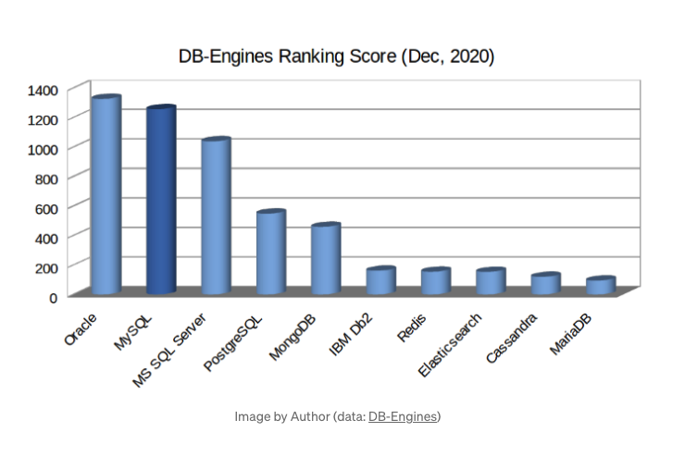
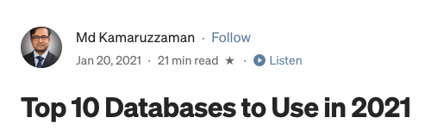
Databases
By Numbers
tml and css

Slide 4
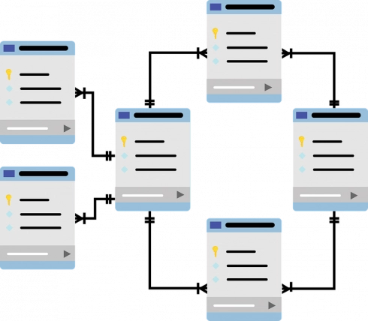
Relational Databases
Tables
Foreign Key
Query
Primary Key
Select Statement
Sub Queries
Normalization

Slide 5
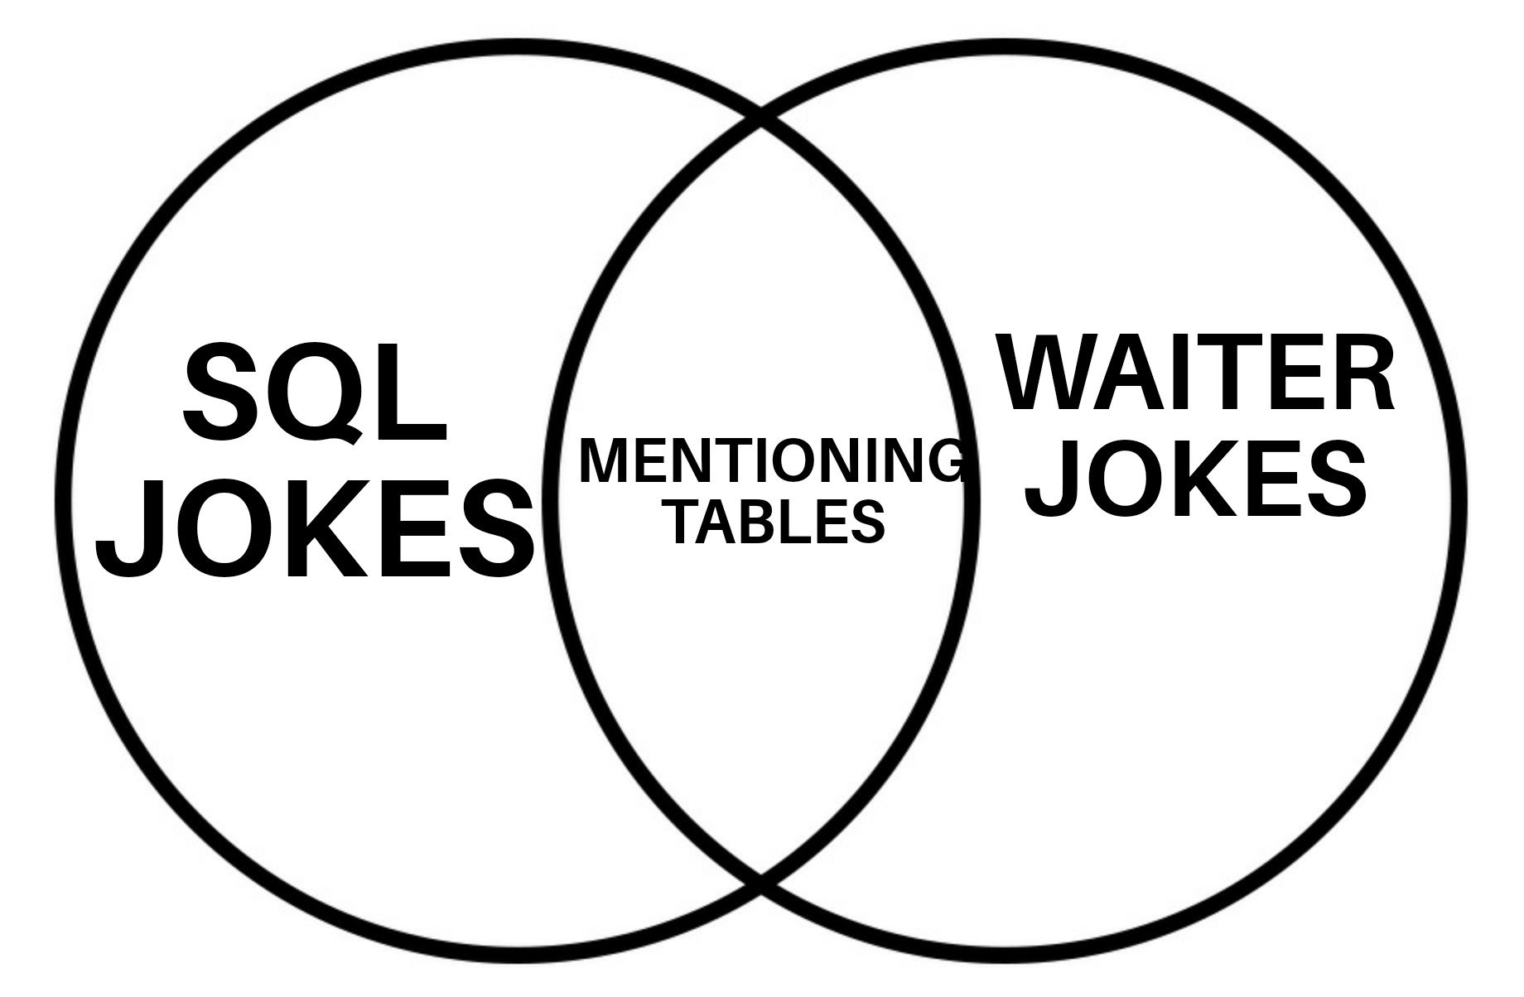
New Memes Available

Slide 6

Download

Slide 7
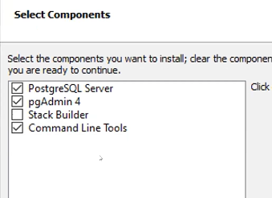
Download
https://www.postgresql.org/download/

Slide 8
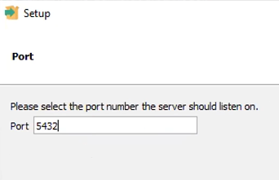
Download
https://www.postgresql.org/download/

Slide 9
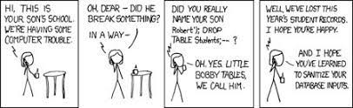
fin

Slide 10
Rangers -81

